Slide 1

SmartAcad AI – An Assignment Tracking and Submission Assistant
SOA Project Review-2
 | Under the Guidance of Dr. Neelima Gogineni Associate Professor, Department of Computer Science and Engineering, KLH CSE Bowrampet Campus
Team Members Name : M. Haswanthi Roll Number : 2420030143 Name : K. Akshitha Roll Number : 2420030146 Name : K. Sreevardhan Roll Number : 2420030711

Slide 2
Abstract
SmartAcad AI is designed as a microservices-based academic management system that helps students manage assignments, deadlines, submissions, and academic progress in one centralized platform. The system includes user management, assignment management, AI-based task prioritization, notifications, submission tracking, progress analytics, and database/file storage. The AI assistant analyzes deadlines, priorities, and pending workload to suggest which assignments need attention first. Students can track upcoming and overdue assignments, while faculty can create assignments, set deadlines, and monitor submissions. The platform uses REST APIs for service communication and role-based access to protect student and faculty data.

Slide 3
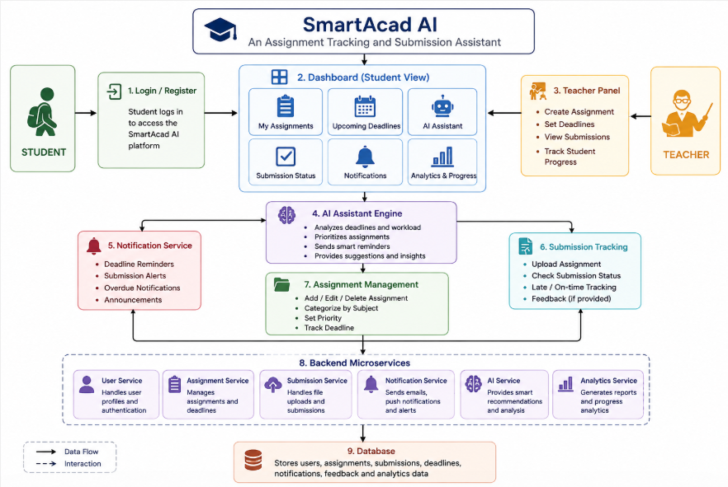
Project Design

Slide 4
architecture and design
1. User Layer
The system supports two main user roles:
• Student – manages assignments, views deadlines, tracks submissions, and monitors progress.
• Faculty – creates assignments, sets deadlines, and monitors student submissions.
2. Frontend Layer
The dashboard provides interfaces for:
• User registration and login
• Viewing and managing assignments
• Checking deadlines and priorities
• Tracking submissions
• Viewing progress and analytics
• Receiving reminders and alerts
• Uploading assignment/submission files
The frontend communicates with backend services through REST APIs.

Slide 5
3. API Gateway
Acts as the single entry point for frontend requests and routes requests to the required microservice.
4. Microservices Layer
The system separates major functions into independent services:
A. User Management Service
B. Assignment Management Service
C. Submission Tracking Service
D. AI Assistant Service
E. Notification Service
F. Analytics & Progress Service
5. Database & File Storage
Stores user details, assignments, submissions, notifications, progress information, and assignment/submission files.
The project specifies MySQL / MongoDB for data storage and cloud storage for files.
6. API Communication
REST APIs are used for communication between the frontend, API Gateway, and microservices.
API flow:
Frontend → API Gateway → Microservice → Database/AI → Response

Slide 6
7. Security Layer
Security is supported through:
• Authentication
• Role-based access
• Protected student and faculty data
• API authorization
8. AI Assistant Design
The AI component analyzes:
• Assignment deadlines
• Assignment priorities
• Pending assignments
• Student workload
• Submission status
It uses this information to prioritize important tasks and provide useful recommendations.

Slide 7
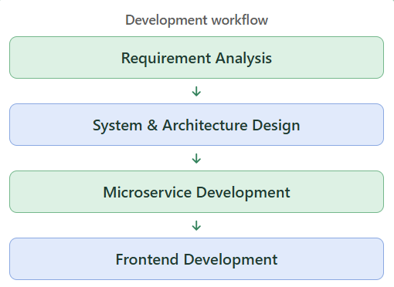
Methodology Adopted – SmartAcad AI
SmartAcad AI follows a modular microservices-based development approach. The system is divided into independent services so that each major function can be developed, tested, and maintained separately.
Key development stages:
Requirement Analysis: Identify assignment-management problems, user roles, and system requirements.
System Design: Design the microservices, database structure, REST APIs, and dashboard.
Backend Development: Develop the application logic and APIs using Java and Spring Boot.
Frontend Development: Build the dashboard for assignments, submissions, reminders, and progress.
Service Integration: Connect the microservices through REST APIs and integrate the AI assistant.
Testing & Security: Test the services and apply authentication and role-based access.

Slide 8
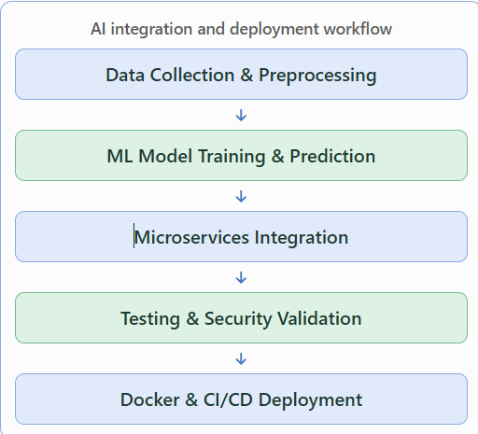
AI Integration, Testing & Deployment
AI Integration:
The AI assistant receives assignment-related information such as deadlines, priorities, pending workload, and submission status. It analyzes this information to support task prioritization and personalized recommendations.
System Integration:
Microservices communicate through REST APIs, while the dashboard displays assignments, deadlines, reminders, submissions, and progress.
Testing:
Individual services, APIs, assignment workflows, submission tracking, and notification functions can be tested independently.
Deployment:
The microservices design allows individual services to be maintained and expanded without tightly coupling the complete application.

Slide 9
